Slide 1
Team-5
E-Commerce Web Application

Slide 2

MD Kamrul Islam(Project Manager)
2017521460107
Sadia Tahsin Mukta
2018511460035
MD Towhidul Islam
2017521460098
Ashraful Islam
2017521460065

Slide 3
Project Introduction:
E-commerce means using the Internet and the web for business transactions and commercial transactions, which typically involve the exchange of value (e.g., money) across organizational or individual boundaries in return for products and services.

Slide 4




Inspired By:
01
Amazon
02
Shopify
03
FlipKart
04
Pathao

Slide 5
Tools and Environment:
Tools:
Django
HTML
Bootstrap
Pillow
X-Mind Map
Dj database URL
dj-static
JavaScript
Jquery
python-decouple
Markdown
bleach
whitenoise
Python dotenv
Environment:
Visual Studio Code
Virtual Environment
Operating System(Windows)

Slide 6
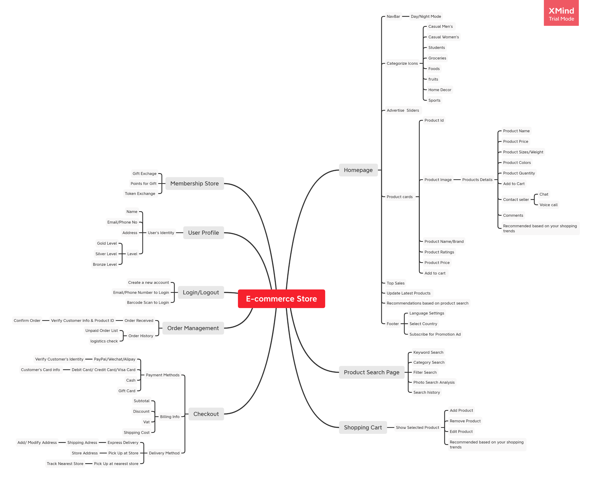

Slide 7
01
02
Product Search Page
Homepage
FEATURES
ONLINE SHOPPING
03
04
Shopping Cart
Checkout

Slide 8
05
Order Management
06
Membership Store
FEATURES
ONLINE SHOPPING
07
08
User Profile
Login/Logout
09
Responsive Layout

Slide 9
Advantages:
E-COMMERCE
ONLINE SHOPPING
01
Convenient and safe
02
Wide product variety
03
Lower prices
04
Saves time

Slide 10
Advantages:
E-COMMERCE
ONLINE SHOPPING
05
Customer data
06
Open always
07
Easier to scale up
08
Wider customer base

Slide 11
Disadvantages:
E-COMMERCE
ONLINE SHOPPING
01
Site Crash
02
Customer can not try before they buy
03
Technical limitations

Slide 12
Responsible For:
MD Kamrul Islam (2017521460107)
01
Responsible for creating Jira, backend, database model,Database Design, Admin Panel, Membership Store, Order Management, Crispy forms and Routing.
Sadia Tahsin Mukta(2018511460035)
02
Responsible for creating all the Web design, X-Mind,Shopping Cart, Product Categorize, Responsive Layout
MD Towhidul Islam(2017521460098)
03
Responsible for checkout Page, product searh page, Login/ Logout
Ashraful Islam(2017521460065)
04
Responsible for User Profile,Setting up the environment, Payment Page

Slide 13
THANK YOU

